Slide 1
Profile management system
Group Members:
1.Shivani Deshmukh.
2.Sayali Bharambe.
3.Komal Hire.
4.Nandini Waychale.
5.Tanisha Waghmare.

Slide 2
INDEX
Introduction.
OBJECTIVE.
SCOPE.
EXCISTING SYSTEM.
PROPOSED SYSTEM.
REQUIREMENTS.
DIAGRAMS.
FEASIBILITY STUDY.
FUTURE ENHANCEMENT.
CONCLUSION.

Slide 3
INTRODUCTION
This project includes the "Profile Generator" web application, which assists users in creating optimized online profiles for various platforms.
Users can create profiles for job search websites (LinkedIn, Indeed), social networking platforms (Instagram, Facebook)
The website analyzes the user's data, recommends enhancements based on current trends and platform particulars, and creates professional profiles.

Slide 4
OBJECTIVES:
Platform Choice
Data Collection
Profile Generation
Proficiency Score
Views & Probability
Enable users to choose between creating profiles for LinkedIn, Instagram, or Indeed.
Display and collect specific information required by the selected platform
generate a profile that meets the specific standards of the platform
Access the profile by providing a proficiency score or feedback.
provide an estimate of the profiles being selected or shortlisted

Slide 5
SCOPE
Comprehensive Profile Management: Users can create and manage profiles for multiple platforms (LinkedIn, Instagram, Indeed) from one interface.
Guidance and Optimization: The website offers guidance on creating optimized profiles, including suggestions and tips for improvement.
Predefined Templates: Users can use predefined templates to quickly generate professional profiles.
Profile Preview: Users can preview how their profiles will appear on the selected platform before finalizing.
Feedback and Improvement Suggestions: The system provides feedback on profile completeness and appropriateness, helping users enhance their profiles for better visibility and selection chances.

Slide 6
Existing system
LIMITED ANALYSIS
OPTION
Users frequently encountered restricted tools for analyzing and understanding their profile performance and audience engagement.
SECURITY CONCERN
The requirement to create accounts on unfamiliar platforms creates privacy and security risks, deterring users from fully engaging in profile creation.
COST BARRIERS
Many platforms impose fees for premium features or templates, limiting accessibility for users with budget constraints.
COMPLEX INTERFACES
Intricate and counterintuitive design elements hinder the user experience, making profile creation a time-consuming and frustrating process.

Slide 7
Proposed system
COMPREHENSIVE ANALYTICS
USER-FRIENDLY
Offer insightful analytics tools to help users understand their profile performance and audience engagement.
Develop an intuitive and user-friendly interface that simplifies the profile creation process and minimizes user frustration.
ACCESSIBILITY
PRIVACY AND SECURITY
Ensure that all core features are available for free, removing financial barriers to profile creation and management.
Offer a secure platform allowing users to create profiles, mandating account creation, and prioritizing data protection.

Slide 8
requirements
HARDWARE REQUIREMENTS:
SOFTWARE REQUIREMENTS:
Processor: i3 and above processor.
Hard Disk: 16GB for 32-bit OS, 32GB for 64-bit OS.
Main Memory:2GB for 32-bit OS or 4GB for 64-bit OS.
Front-End: HTML,CSS,JAVA-SCRPIT
Back-End: ASP.NET CORE.
Database: Sql Server.
Operating System: Windows 10 or above version
Tools: Visual Studio 2022

Slide 9
diagram

Slide 10
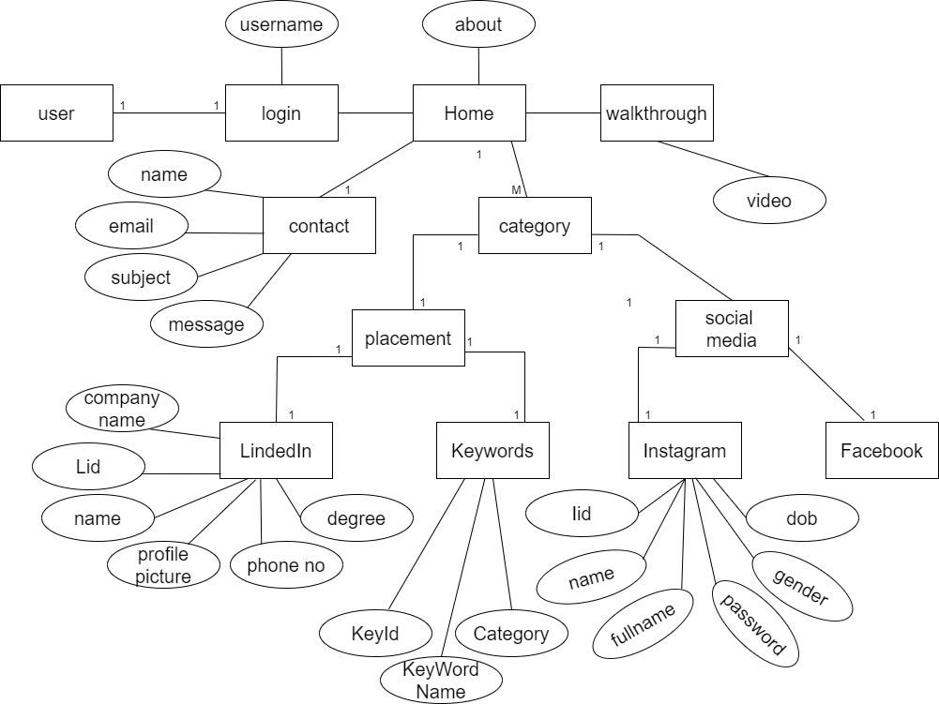
ER-DIAGRAM

Slide 11
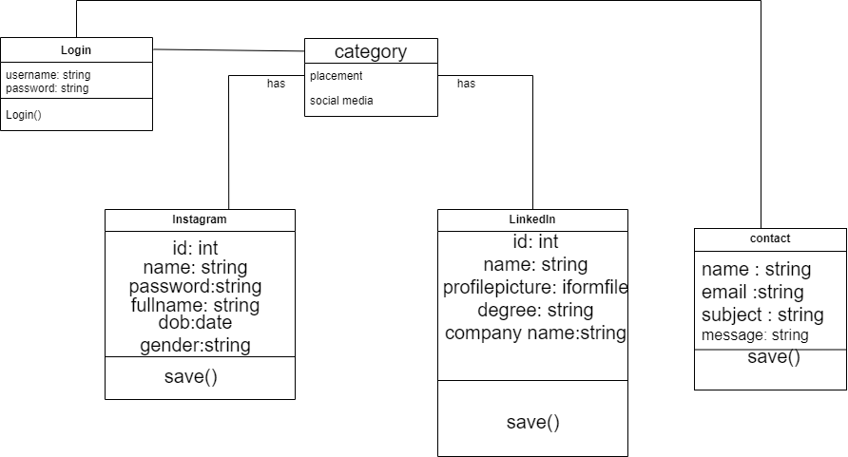
Class Diagram

Slide 12
FEASIBILITY STUDY
Technical
Feasibility
Economic
Feasibility
Operational
Feasibility

Slide 13
FUTURE ENHANCEMENT
Dynamic Profile Updates
AI-Driven Profile Recommendations:
Profiles could automatically
update based on real-time
data and user interactions.
Systems could suggest a profile
updates or new information
based on user behavior and
preferences.

Slide 14
conclusion
This project introduces a comprehensive Profile Management System designed to streamline the creation, management, and optimization of user profiles across multiple platforms. The system will empower users to effortlessly construct and maintain consistent profiles while leveraging advanced analytics to identify areas for improvement.

Slide 15
THANK YOU

